Slide 1
Digital Portfolio
STUDENT NAME: SADHANA.B
REGISTER NO AND NMID: 212401753/EDFEA10A4DFDB63A61C4B0FAE1BF3F13
DEPARTMENT: BCA
COLLEGE: COLLEGE/ UNIVERSITY :NAZARETH COLLEGE OF ARTS AND SCIENCE/ MADRAS UNIVERSITY

Slide 2
PROJECT TITLE
Student Digital Portfolio

Slide 3
AGENDA
Problem Statement
Project Overview
End Users
Tools and Technologies
Portfolio design and Layout
Features and Functionality
Results and Screenshots
Conclusion
Github Link
3/21/2024 Annual Review

Slide 4
PROBLEM STATEMENT
In today's increasingly digital world, traditional paper-based portfolios are becoming outdated, inefficient, and less accessible. Students, professionals, and creatives often struggle to present their work in a visually appealing and organized manner that is easy to share and update. There is a lack of centralized, interactive, and user-friendly platforms where individuals can showcase their skills, achievements, and projects in a digital format. This limits opportunities for personal branding, professional networking, and career advancement.

Slide 5
PROJECT OVERVIEW
A Digital Portfolio is an online representation of an individual’s skills, achievements, and work. It is designed to showcase personal, academic, and professional accomplishments in a structured and creative manner. Unlike traditional paper-based resumes, a digital portfolio provides interactive access to projects, certifications, and creative work, making it easier for others to evaluate one’s capabilities.
The main objective of creating a digital portfolio is to establish a strong professional presence. It helps students, job seekers, and professionals highlight their skills, talents, and experiences effectively. It also acts as a platform for continuous learning, where new projects and achievements can be added over time

Slide 6
WHO ARE THE END USERS?
For a Digital Portfolio Project, the end users are:
Students – to showcase academic work, skills, and achievements.
Job Seekers / Fresh Graduates – to present resumes, projects, and certifications to recruiters.
Professionals – to highlight work experience, creative projects, and technical expertise.
Recruiters / Employers – to evaluate a candidate’s skills and suitability for jobs.
Teachers / Mentors – to assess student progress and project work.
Clients (for freelancers) – to check portfolios before giving projects.
👉 In short: Students, professionals, recruiters, and clients are the main end users.

Slide 7
TOOLS AND TECHNIQUES
Tools
Web Development Tools: HTML, CSS, JavaScript
Frameworks: Bootstrap, React (for responsive design)
Content Management Systems (CMS): WordPress, Wix, Google Sites
Design Tools: Canva, Figma, Adobe Photoshop/Illustrator
Code Editors: VS Code, Sublime Text, PyCharm
Hosting Platforms: GitHub Pages, Netlify, Google Drive, Cloud Hosting
Document & File Tools: MS Office, Google Docs, PDF tools for uploading certificates
Techniques
Responsive Web Design – to make the portfolio accessible on mobile and desktop.
UI/UX Design Principles – for easy navigation and attractive layout.
Content Organization – dividing sections like About Me, Skills, Projects, and Certifications.
Version Control (Git/GitHub) – to track changes and maintain portfolio updates.
SEO (Search Engine Optimization) – to make the portfolio discoverable online.
Multimedia Integration – embedding images, videos, documents, and links.
Continuous Updating – regularly adding new skills, certifications, and projects.

Slide 8
POTFOLIO DESIGN AND LAYOUT
The digital portfolio should have a clean, simple, and professional design. The layout typically includes: Home/Intro, About Me, Resume & Skills, Projects, Certifications, and Contact. A consistent color theme, clear fonts, and responsive design ensure easy navigation. Visuals and multimedia make the portfolio engaging, while a minimalistic approach keeps it neat and user-friendly.
8

Slide 9
FEATURES AND FUNCTIONALITY
The digital portfolio includes features like organized sections (About Me, Skills, Projects, Certificates), responsive design for mobile and desktop, and easy navigation through menus. It supports multimedia integration (images, videos, documents) and allows easy sharing via links. Functionality focuses on user-friendly design, fast loading, and regular updates to showcase new achievements.

Slide 10
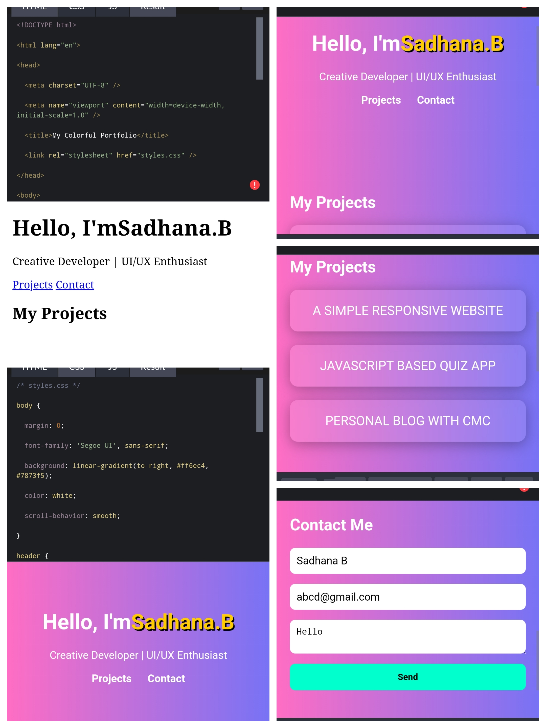
RESULTS AND SCREENSHOTS
3/21/2024 Annual Review
10

Slide 11
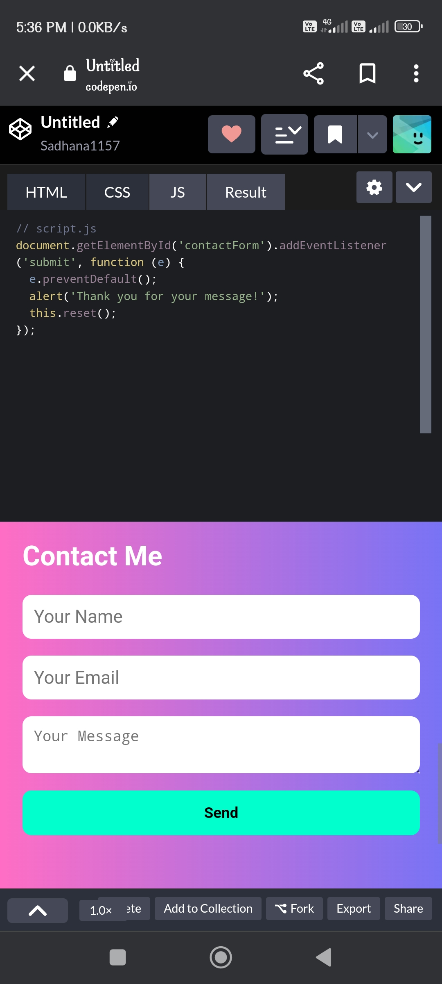
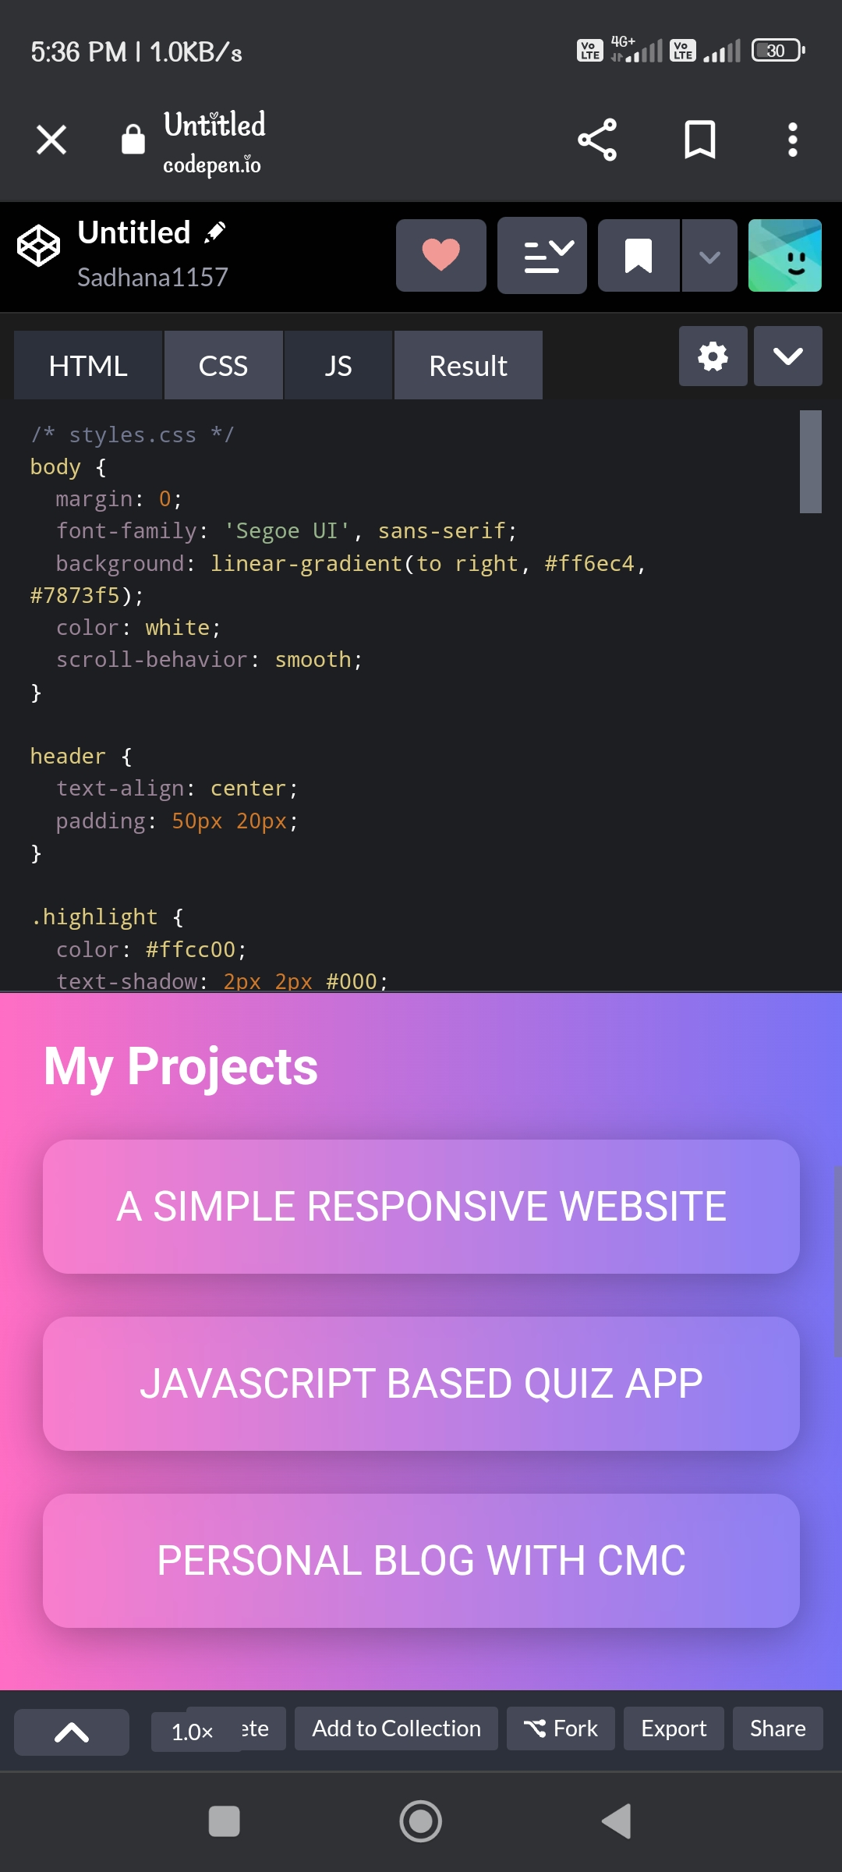
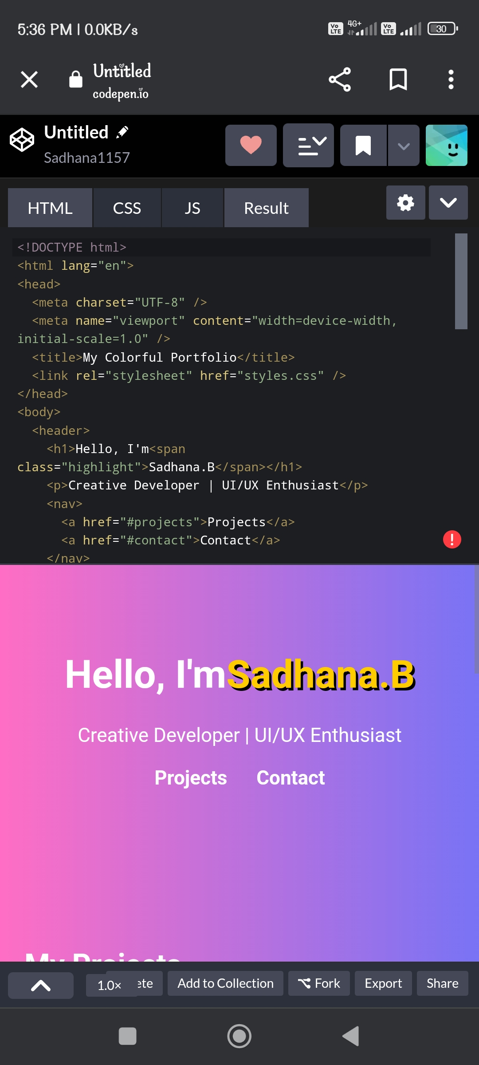

Slide 12
CONCLUSION
The Digital Portfolio project plays a vital role in building a strong professional identity in today’s digital world. Unlike traditional resumes, it provides an interactive and engaging way to showcase skills, projects, and achievements. By organizing content into structured sections such as About Me, Skills, Projects, and Certifications, the portfolio offers a clear and complete view of an individual’s capabilities.
This project highlights the importance of creativity, technical knowledge, and design principles in presenting information effectively. With features like responsive design, multimedia integration, and easy accessibility, the portfolio becomes a powerful tool for students, job seekers, and professionals. It not only enhances career opportunities but also serves as a platform for continuous growth, where new skills and accomplishments can be added over time.
12

